Slide 1

Airline passenger satisfaction

Slide 2
Introduction
Passenger satisfaction is a key indicator of airline performance and competitiveness. It reflects how well an airline meets or exceeds the expectations and needs of its passengers.
which contributes to an airline's profitability and increased market share
Quality assurance is fundamental for consumer satisfaction and trust.

Slide 3
Outline of project
Understand and identify the features and target.
Check data type of each field and make necessary conversions.
Apply preprocessing steps and take necessary action like missing value
treatment, encoding and scaling.
Check for correlation between various features and target value.
Remove the features which has less impact on the target value.
Explore the data by plotting the charts and get some insights.
Build a model by applying various available algorithms.

Slide 4
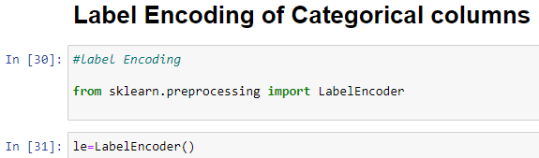
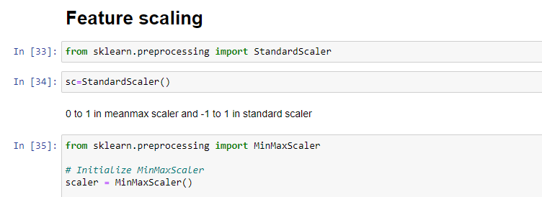
Preprocessing techniques
Encoding
label encoder is used to convert the categorical
values of the target column into
numerical values.
Scaling
Standard Scaler removes the mean and scales
each feature/variable to unit variance. This
operation is performed feature-wise in an
independent way.

Slide 5
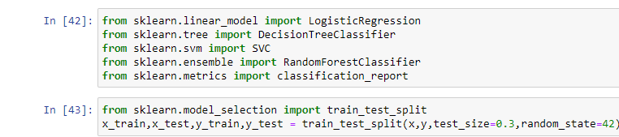
ALGORITHMS USED IN THE MODEL

Slide 6
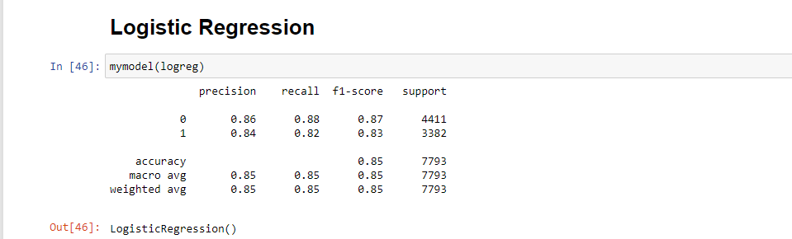
LOGISTIC REGRESSION
Logistic regression is a process of modeling the probability of a discrete outcome
given an input variable. The most common logistic regression models a binary
outcome; something that can take two values such as true/false, yes/no, and soon.

Slide 7
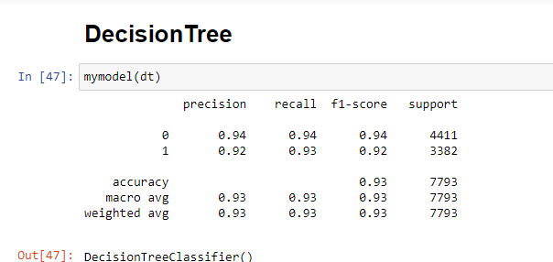
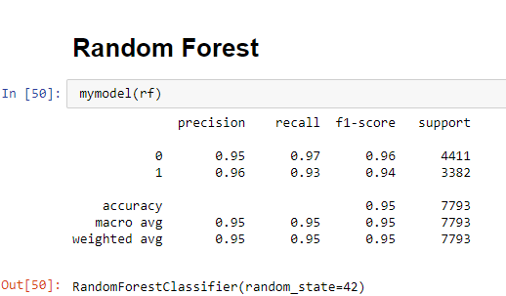
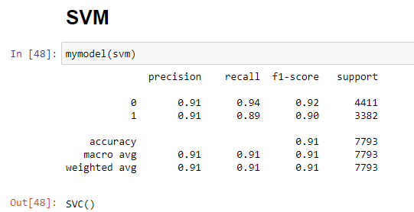
CHECKING THE ACCURACY USING, SVC ,DECISION TREE CLASSIFIER and random forest

Slide 8
Conclusion
In this project, we build various models like logistic regression, knn classifier,decision tree classifier & random forest classifier
A Random Forest Classifier gives the highest accuracy score of 95.00 percent among all the ML Models.
So for the Airline passenger Satisfaction prediction Random Forest is best model

Slide 9
Thank you

